Slide 1

Covid-19 Vaccines Analysis

Slide 2
Problem Definition and Design Thinking
In this part you will need to understand the problem statement and create a document on what have you understood and how will you proceed ahead with solving the problem. Please think on a design and present in form of a document.

Slide 3
Problem Definition
The problem is to conduct an in-depth analysis of Covid-19 vaccine data, focusing on vaccine efficacy, distribution, and adverse effects. The goal is to provide insights that aid policymakers and health organizations in optimizing vaccine deployment strategies. This project involves data collection, data preprocessing, exploratory data analysis, statistical analysis, and visualization.

Slide 4
Data Collection
Data Collection. Data collection is the process of gathering and measuring information on variables of interest, in an established systematic fashion that enables one to answer stated research questions, test hypotheses, and evaluate outcomes.

Slide 5
Data Preprocessing
Data preprocessing is an important step in the data mining process. It refers to the cleaning, transforming, and integrating of data in order to make it ready for analysis. The goal of data preprocessing is to improve the quality of the data and to make it more suitable for the specific data mining task.

Slide 6
Exploratory Data
Exploratory Data Analysis (EDA) refers to the method of studying and exploring record sets to apprehend their predominant traits, discover patterns, locate outliers, and identify relationships between variables. EDA is normally carried out as a preliminary step before undertaking extra formal statistical analyses or modeling.

Slide 7
Statistical Analysis
Statistical analysis is the process of collecting and analyzing large volumes of data in order to identify trends and develop valuable insights. In the professional world, statistical analysts take raw data and find correlations between variables to reveal patterns and trends to relevant stakeholders

Slide 8
Visualization
Visualization or visualisation (see spelling differences) is any technique for creating images, diagrams, or animations to communicate a message. Visualization through visual imagery has been an effective way to communicate both abstract and concrete ideas since the dawn of humanity.

Slide 9
Insights & Recommendations
Data science is not only about analyzing data, but also about communicating the results and implications to stakeholders. However, presenting complex data insights and recommendations can be challenging, especially when you have to deal with different audiences, formats, and goals.

Slide 10
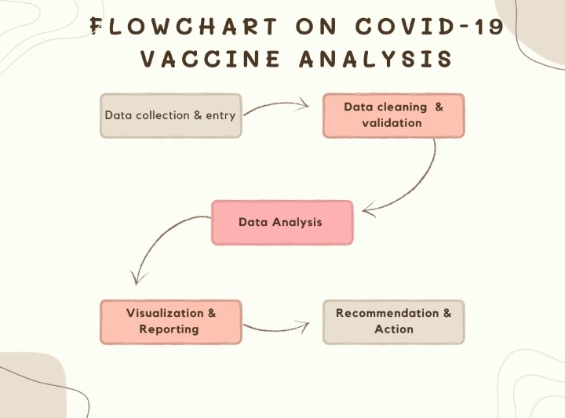
FLOW CHART

Slide 11


